Slide 1
No-Till Farming
Increasing water absorption and minimizing soil and nutrient loss

Slide 2
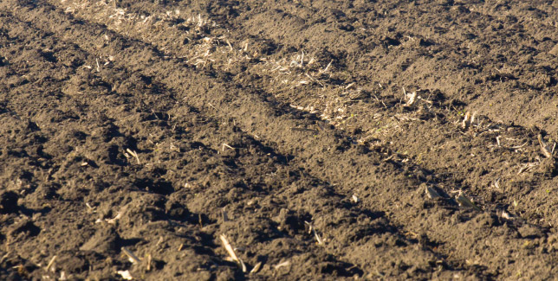
Conventional Tillage
Plant residue is buried

Slide 3
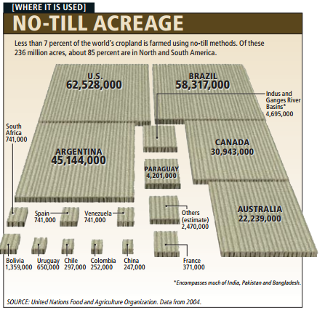
Conservation tillage

Slide 4
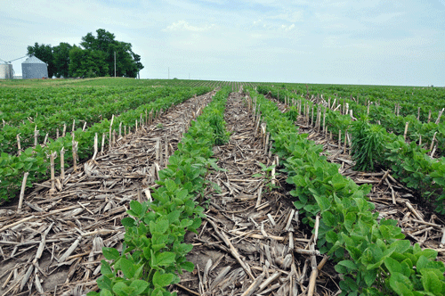
Conservation tillage
No-till

Slide 5
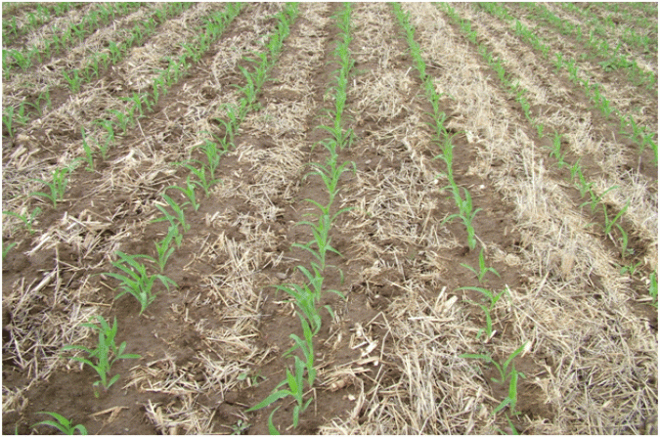
Conservation tillage
Reduced or minimum tillage

Slide 6
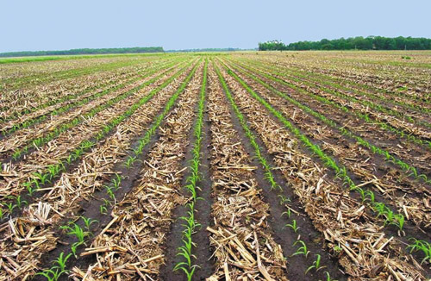
Conservation tillage
Strip or zonal tillage

Slide 7
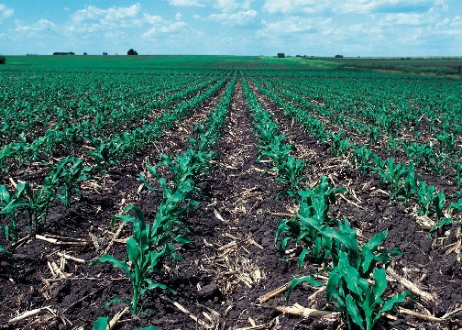
Conservation tillage
Mulch tillage

Slide 8
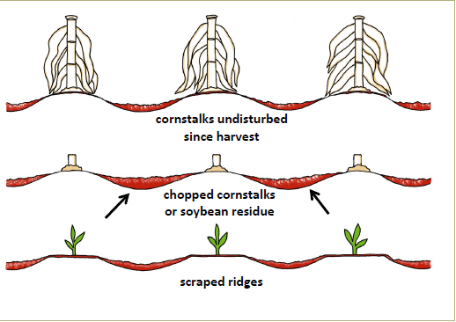
Conservation tillage
Ridge tillage

Slide 9
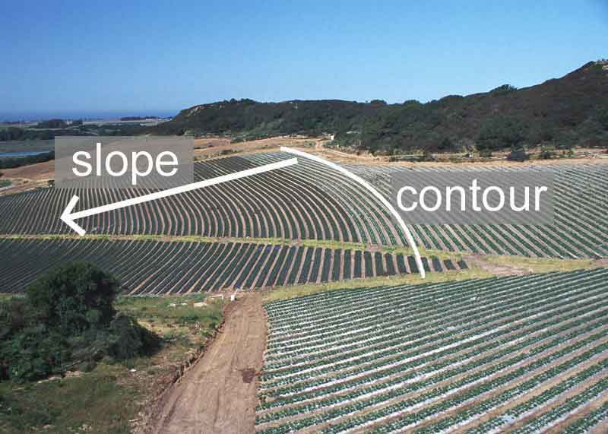
Conservation tillage
Contour tillage

Slide 10
Conservation tillage
https://youtu.be/rp0PBUdddek

Slide 11
Are farmers using conservation practices?

Slide 12
Are farmers using conservation practices?

Slide 13
Conservation tillage - benefits
Reduces labor, saves time: As little as one trip for planting compared to two or more tillage operations means fewer hours on a tractor and fewer labor hours to pay ... or more acres to farm. For instance, on 500 acres the time savings can be as much as 225 hours per year. That’s almost four 60-hour weeks.
Saves fuel: Save an average 3.5 gallons an acre or 1,750 gallons on a 500-acre farm.
Reduces machinery wear: Fewer trips save an estimated $5 per acre on machinery wear and maintenance costs—a $2,500 savings on a 500-acre farm.
Improves soil tilth: A continuous no-till system increases soil particle aggregation (small soil clumps) making it easier for plants to establish roots. Improved soil tilth also can minimize compaction. Of course, compaction is also reduced by reducing trips across the field.
Increases organic matter: The latest research shows the more soil is tilled, the more carbon is released to the air and the less carbon is available to build organic matter for future crops. In fact, carbon accounts for about half of organic matter.

Slide 14
Conservation tillage - benefits
Traps soil moisture to improve water availability: Crop residue traps water in the soil by providing shade. The shade reduces water evaporation. Residue acts as tiny dams slowing runoff and increasing the opportunity for water to soak into the soil. Infiltration increases by the channels (macropores) created by earthworms and old plant roots. Continuous no-till can result in as much as two additional inches of water available to plants in late summer.
Reduces soil erosion: Crop residues on the soil surface reduce erosion by water and wind. Depending on the amount of residues present, soil erosion can be reduced by up to 90% compared to an unprotected, intensively tilled field.
Improves water quality: Crop residue helps hold soil along with associated nutrients (particularly phosphorous) and pesticides on the field to reduce runoff into surface water. In fact, residue can cut herbicide runoff rates in half. Additionally, microbes that live in carbon-rich soils quickly degrade pesticides and utilize nutrients to protect groundwater quality.
Increases wildlife: Crop residues provide shelter and food for wildlife, such as game birds and small animals.
Improves air quality: Crop residue left on the surface improves air quality because it: Reduces wind erosion, thus it reduces the amount of dust in the air; Reduces fossil fuel emissions from tractors by making fewer trips across the field; and Reduces the release of carbon dioxide into the atmosphere by tying up more carbon in organic matter.

